Slide 1
Project Meeting
2018/9/19

Slide 2










Architecture
Cloud Layer
node
node
Fog Layer
node
node
node
Sensor Layer
Smart meter
Smart meter
Smart meter
Smart meter
Smart meter
Smart meter

Slide 3




Deep Learning Training Environment
IoT device monitor
Cloud
Layer
Hash data & stack number
Hash data & data
Hash data & stack number
Hash data & data
HTTP
Protocol
parameter & weight
parameter & weight
Fog
Layer
container
MQTT Broker
container
MQTT Broker
blockchain
ledger
Deep Learning
Detection Model
blockchain
ledger
Deep Learning
Detection Model
ledger
sharing
MQTT
Protocol
Sensor
data
Sensor
data
Senor
Layer
Smart Meter Simulator
Normal Model
Anomaly
Model
Sensor Fault Model

Slide 4
Schedule
First Season
Gateway building
Communication building
Cloud Service building
Second Season
Implement Docker container
Implement BlockChain node (with BC group)
Implement Deep Learning Model (with DNN group)
Third Season
Design Fault Simulator for Smart Grid
Optimize Cloud Service

Slide 5
First Season
Gateway building
Build LoRa gateway
Use default gateway
Use private gateway
Communication building
Sensor ↔ Node communication (MQTT)
Node ↔ Node communication (MQTT/HTTP)
Node ↔ Cloud communication (MQTT/HTTP)
Cloud Service building
Hyperledger Fabric
Kubernetes & Docker container
Deep Learning Training Environment

Slide 6


Build LoRa gateway
Two ways:
Use default gateway
Device: Raspberry Pi, LoRa module (Antenna), LoRa gateway(Advantech)
Use private gateway
Device: Raspberry Pi, LoRa module (Antenna), private gateway(LoRa dongle+Raspberry Pi)
Sensor

Slide 7
Communication
Sensor ↔ Node communication (MQTT)
Raspberry Pi3(sensor)
→ Raspberry Pi3 (node)
Node ↔ Node communication (MQTT/HTTP)
Raspberry Pi3 (node)
→ Raspberry Pi3 (node)
Raspberry Pi3 (node)
→ PC (node)
PC (node)
→ Raspberry Pi3 (node)
Node ↔ Cloud communication (MQTT/HTTP)
PC (node)
→ Cloud Server (server)

Slide 8
Cloud Service
Hyperledger Fabric
Help BC group build Hyperledger Fabric
Kubernetes & Docker container
Build Kubernetes and Docker environment, and make sure both work.
Deep Learning Training Environment
Build DL training environment, make sure DNN group can work.

Slide 9
LoRa Gateway
--- Pricing ---

Slide 10
Price comparison
 | 研華科技(Advantech) |  |  | 正文科技(Gemtek)
品名 | WISE-3610ILS-51A1N | WISE-DK1510-MBNAE | 電源線 | LoRa Femto 室內型無線閘道器 (含電源供應器、天線) | LoRa SiP EVK 模板 (天線、兩條杜邦線)
數量 | 1 | 3 | 1 | 1 | 2
單價 | 24,300 | 12,650 | 60 | 6,720 | 970
總金額(含稅) | 65,426 |  |  | 9,093
Notes:
3610*1+DK1510*1= 38,860

Slide 11
Gateway comparison
 | WISE-3610ILS-51A1N(研華) | Indoor Femto Gateway(正文)
CPU | QCA Quad-core ARM Cortex A7 CPU 716 MHz | Network SOC with 580MHz MIPS CPU Core
RAM | On-board DDR3L 256MB | 250MB
Flash | 128 MB | 500MB
Number of Channels | 8 | 8
WiFi | 2x2 IEEE802.11a/b/g/n/ac MU-MIMO 2.4GHz | 802.11 b/g/n 2.4GHz
備註 | 10% ~ 95% @ 40°C relative humidity, non-condensing | indoor

Slide 12
Lora node comparison
 | WISE-1510(研華) | LoRa SiP EVK 模板(正文)
MCU | STM ARM Cortex-M4 Processor (1.25DMIPS/MHz) | STM32L073xZ - ARM Cortex® -M0+ (32 bit RISC, 32MHz) (0.95DMIPS/MHz)
RAM | 64KB | 20KB
Flash | 256KB | 192KB
Number of Channels | Spreading Factor: 7 ~ 12 | 64
Operating Temperature | -40 ~ 85° C | -20ºC ~ 70ºC
Dimensions | 22 x 30mm | 56 x 24mm
Remarks | 5% ~ 95% Relative Humidity, non-condensing
Notes:
的效能
DMIPS=
Dhrystone是测量处理器运算能力的最常见基准程序之一，是程序的一个指令常用于处理器的整型运算性能的测量。
MIPS/MHz 表示 CPU 在多少MHz的运行速度下可以执行多少个MIPS

Slide 13
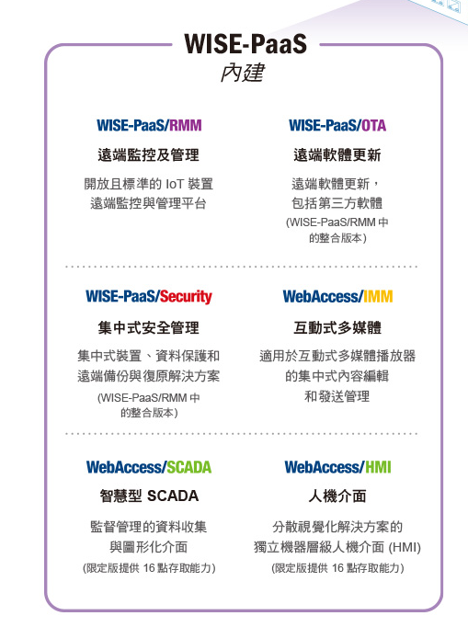
WISE-DK1510-MBNAE
WISE-1510 LPWAN LoRa 物聯網節點
WISE-ED20 除錯板卡
WISE-DB1500 開發板內建溫溼度感測器
壓力感測及空氣品質PM2.5監控感測器
免費試用帳號體驗 WISE-PaaS
兩年保固

Slide 14
BlockChain Group

Slide 15
Goal
Blockchain for data integrity
Design Blockchain Platform using HyperLedger Fabric
Implement Agent Layer using Kubernetes/Docker

Slide 16
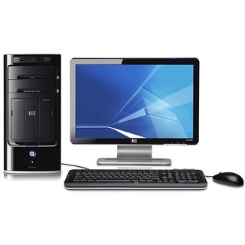


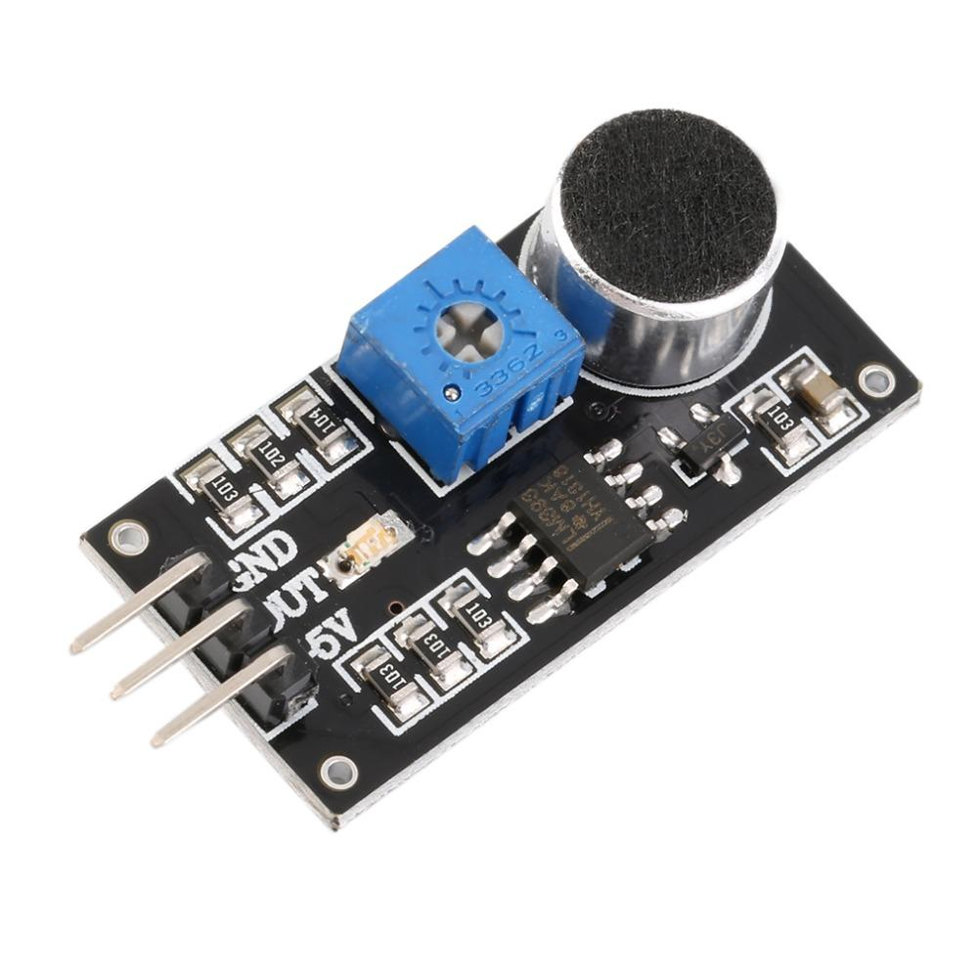
BC Architecture
Policy list
data
Hash

Slide 17
BlockChain - Local
Device1
Device2
Device3
T(1)
P(2)
T(3)
Policy list
W(1)
T(2)
P(3)
Access sign
P(1)
Stack number &hash data
W(1)

Slide 18
Cloud BC
Stack 1
Stack 2
Data(T1)
Hash
Data(W1)
Hash
Data(W2)
Hash
Data(P3)
Hash
Data(P1)
Hash
Data(T2)
Hash

Slide 19
Schedule
First
HyperLedger Fabric in Docker building
Blockchain in fog computing architecture
Build a basic blockchain for one sensor-node-cloud
Second
Implement multiple sensor, node blockchain
Consensus
Privacy
Third
Intergation

Slide 20
DNN Group

Slide 21
1st year goal
Construct/Train LSTM RNN Model
Design Fault Simulator for Smart Grids

Slide 22
What to do on LSTM
Normal data
Sent data to blockchain
Anomaly Detection
False data injection
smart meter fault

Slide 23
How to build
Collect data
Use dataset and process data
Training in cloud
LSTM Architecture
One layer 、two layer etc…
Parameter adjustment
Sigmoid/relu/tanh
Epoch
Momentum

Slide 24
How to test
Use fault simulator collect sensor data
Normal data
Abnormal data

Slide 25
Schedule
End of 2018:
Find dataset and process data
Build environment
Survey paper
Train LSTM model
End of April 2019:
Collect data from sensor to test LSTM model
Improve model
Communicate with blockchain
End of July 2019:
Design Fault Simulator for Smart Grids
Test abnormal data
Improve model

